Slide 1
Java ESAD (Enterprise sytem analysis and design) and Clean code
By
Md. Naym Hossain

Slide 2
ESAD (Enterprise System Analysis and design)

Slide 3
System Analysis and design
Preparing System Specification from System Requirements
Use Cases and Rich Pictures identify many system elements and dependencies
Use Cases help identify user-system interactions, transactions or processes
Rich Pictures help identify different roles people play, their concerns, overall process flow dependencies, and scope of overall problem domain.
Overall, system analysis serves as the bridge between the requirements of the problem domain and the (architectural) design of a solution.
Fundamental assumption
System analysis focuses on what the enterprise system is suppose to do, not how the system should be implemented.
System specification captures the "what"
System design captures the "how"
System specification and modelling represents the solution to the problems described by the system's requirements!

Slide 4
What do system specification Specify?
Specifications require identification of:
enterprise system components,
user-system interfaces (and associated input devices),
display or navigation screens, data entry forms, printed reports
user processes for interacting with the system,
information processes performed within the information system (technology),
user inputs and system outputs,
internal system inputs and outputs between system components,
process control guidance or decision-making constraints,
human roles or automated system components that enables processing steps,
error conditions, error handling/signaling
erroneous user input
erroneous system output
erroneous internal system inputs/outputs
boundary values or anomalous values in inputs or outputs that require special handling

Slide 5
What do system specification Specify?
Specified elements and dependencies need to be organized as abstractions:
Hierarchical abstraction:
Top-level: the Big picture of the system
Middle-levels: sub-systems (a configured collection of components or internal sub-systems), sub-sub-systems, etc.
Lowest-level: where system/software mechanisms operate
Two kinds of hierarchical system abstractions of interest:
Generic: from most general (domain-independent) to most specific (domain-specific)
Taxonomic: from whole to part
Each is orthogonal to the other
Generic and domain-specific component abstraction:
Components are to be parts of the implemented information system
Components have interfaces through which inputs and outputs pass
User-system interface
Sub-system to sub-system interface
Component to component
Taxonomic classification:
System to sub-system, sub-system to sub-sub-system, etc. to component.
How the parts compose the whole; how the whole is decomposed into parts

Slide 6
System modeling
All system specification models require some sort of data dictionary, lexicon, or meta-model that identifies and defines (provides a model schema)
people (roles): e.g., an enterprise organizational chart or roles, skills, or process assignments,
business strategies and rules,
information technology components
and how they are interrelated into an enterprise system configuration.
each of these requires a separate model

Slide 7
Entity-relation (er) data modeling
Entities are essentially objects
ER can be viewed as object-based, but NOT object-oriented!
Entities have attributes, attributes have values, values have instances, etc., as in System Specifications
ER data models sometimes also called ERA (entity-relation-attribute) or OAR (object-attribute-relation).
Entity data sets are often represented as tables,
the table (relational) schema defines its application data model (or application meta-data) as a collection of entity attributes (and their primitive data types, e.g., string, integer, real, timestamp, currency, etc.)
table columns denote the entity's attributes,
table rows denote the entity's instances.
ER data sets (e.g., a relational database) generally have a flat structure and many instances of each entity

Slide 8
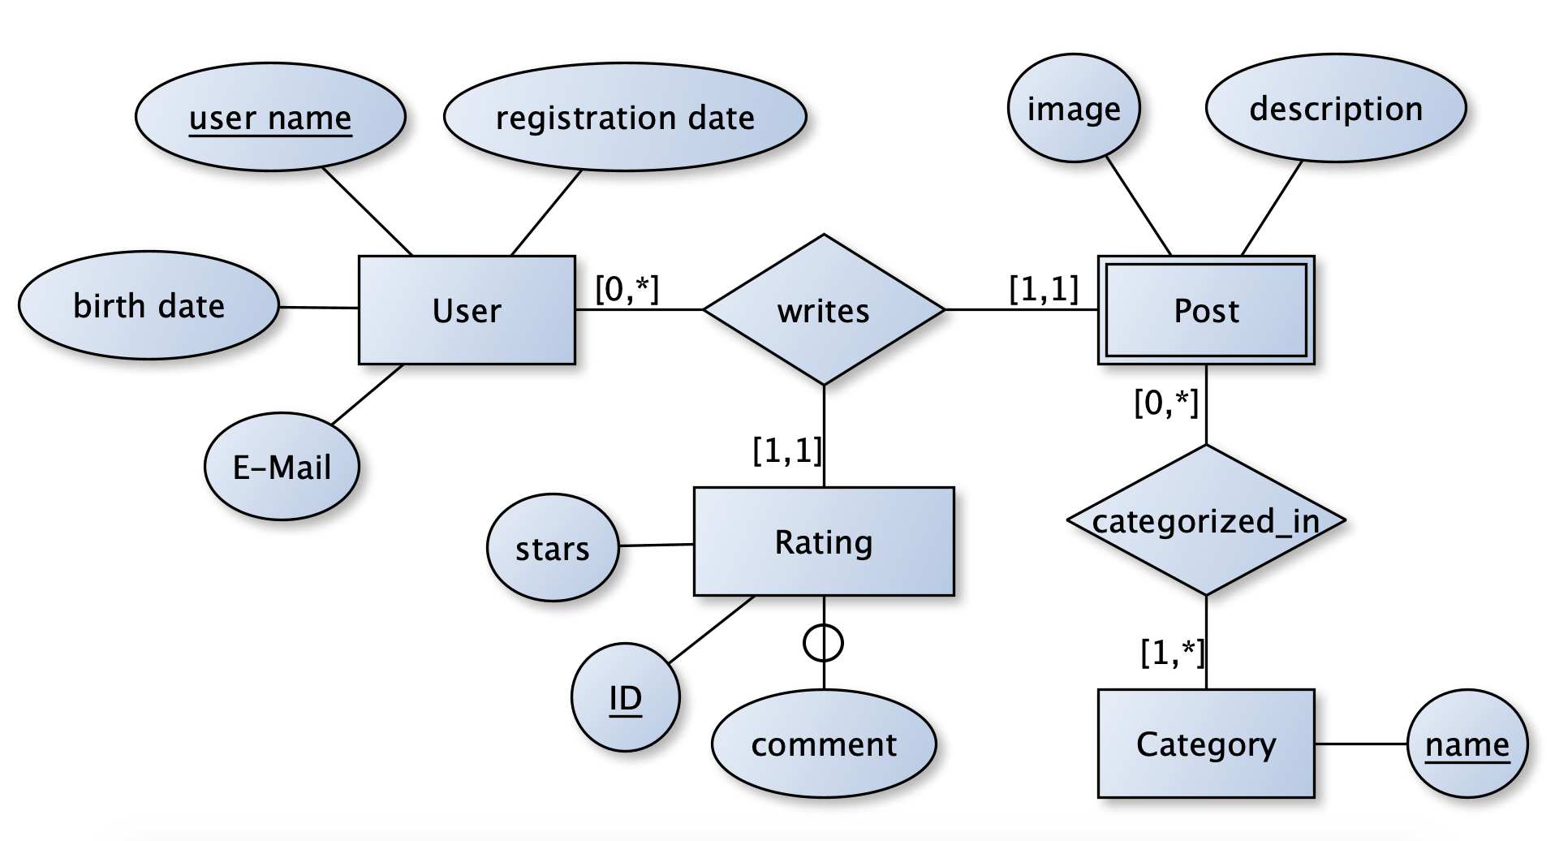
Entity-relation (er) data modeling
ER data models are visualized using ER Diagrams

Slide 9
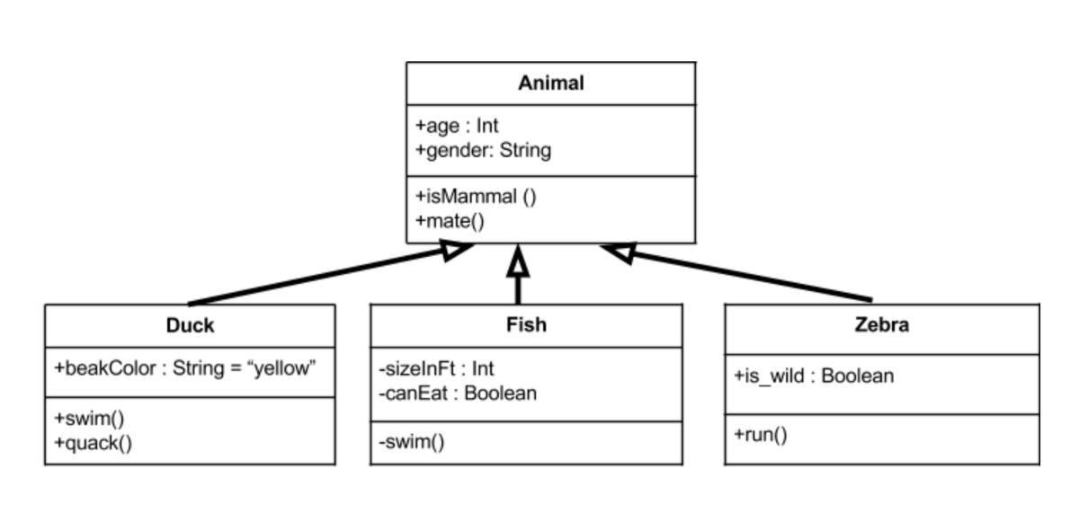
object-oriented (oo) data modeling
ER models supporting inheritance!
OO models are usually modeled as object hierarchies
Processes, workflow and messages are usually hidden within object methods
OO models can be visualized using the Unified Modeling Language

Slide 10
component-based modeling
ER models supporting components as system entities

Slide 11
Writing Clean code

Slide 12
project structure
Maven suggested convention
src/main/java: For source files
src/main/resources: For resource files, like properties
src/test/java: For test source files
src/test/resources: For test resource files, like properties

Slide 13
source file structure
A typical ordering of elements in a source file look:
Package statement
Import statements
All static imports
All non-static imports
Exactly one top-level class
Class variables
Instance variables
Constructors
Methods

Slide 14
naming convention
“… if you know what something does, you got a pretty good chance guessing the name of the Spring class or interface for it …”
Rod Johnson, the creator of Spring
Class in terms of object-oriented concepts is a blueprint for objects which often represent real-world objects. Hence it's meaningful to use nouns to name classes describing them sufficiently.
Variables in Java capture the state of the object created from a class. The name of the variable should describe the intent of the variable clearly:
public class Customer { }
public class Customer {
private String customerName;
}

Slide 15
naming convention
Methods in Java are always part of classes and hence generally represent an action on the state of the object created from the class. It's hence useful to name methods using verbs:
Constants should use all capital letters divided with underscore:
Avoid special characters and numbers in variable naming:
public class Customer {
private String customerName;
public String getCustomerName() {
return this.customerName;
}
}
final int MAX_AGE = 20;
// Bad practice
User user1 = new User();
User user2$ = new User();

Slide 16
avoid magic numbers
A magic number means we are assigning a number with no clear meaning. Sometimes we use a value for a specific purpose, and we don't assign the value in a meaningful variable. The problem is that when someone works with your code, then the person doesn't know the meaning of that direct value.
// Bad practice
for( int i=0; i<50; i++) {
//do something
}
// Good practice
int NUMBER_OF_STUDENTS = 50;
for( int i=0; i<NUMBER_OF_STUDENTS; i++) {
//do something
}

Slide 17
avoid Large method
When a function or a class is much larger, then it is suggested to separate it into multiples. This will make our code easier, clean, easy to understand, and also reusable.
// Good practice
public String getCustomerName(String rentalId) {
int rentalIdx = getRentalIdxById(rentalId);
return rentals
.get(rentalIdx).getCustomerName();
}
private int getRentalIdxById(String rentalId) {
for (int i = 0; i < rentals.size(); i++) {
BookRental rental = rentals.get(i);
if (rental.getId().equals(rentalId)) {
return i;
}
}
throw new RentalNotFoundException();
}
// Bad practice
public String getCustomerName(String rentalId) {
for (int i = 0; i < rentals.size(); i++) {
BookRental rental = rentals.get(i);
if (rental.getId().equals(rentalId)) {
return rental.getCustomerName();
}
}
throw new RentalNotFoundException();
}

Slide 18
avoid Too many method params
Parameters are essential for methods to work as per specification. But, a long list of parameters can make it difficult for someone to read and understand the code.
We may consider bundling parameters into custom-types but must be careful not to dump unrelated parameters into a single type
public boolean setCustomerAddress(String firstName, String lastName,
String streetAddress, String city,
String zipCode, String state,
String country, String phoneNumber) {
}
// This can be refactored as below to increase readability
public boolean setCustomerAddress(Address address) {
}

Slide 19
avoid code repetition
Repeated code means a code block that is repeated in your code more than once. This means your code portion needs to be extracted into a function.
// Good practice
public String getCustomerName(String rentalId) {
int rentalIdx = getRentalIdxById(rentalId);
return rentals
.get(rentalIdx).getCustomerName();
}
public void deleteRental(String rentalId) {
rentals.remove(getRentalIdxById(rentalId));
}
private int getRentalIdxById(String rentalId) {
for (int i = 0; i < rentals.size(); i++) {
BookRental rental = rentals.get(i);
if (rental.getId().equals(rentalId)) {
return i;
}
}
throw new RentalNotFoundException();
}
// Bad practice
public String getCustomerName(String rentalId) {
for (int i = 0; i < rentals.size(); i++) {
BookRental rental = rentals.get(i);
if (rental.getId().equals(rentalId)) {
return rental.getCustomerName();
}
}
throw new RentalNotFoundException();
}

Slide 20
Optimize code
Don’t write three lines of code if the same thing can be done with only one line. It means that before adding some block of code you need to think about the best approach you can apply to this piece of code.
boolean hasCreditCard(User user) {
if (user.hasCard) {
return true;
} else {
return false;
}
}
// Optimised
boolean hasCreditCard(User user) {
return user.hasCard;
}

Slide 21
code comments
Code comments can be beneficial while reading code to understand the non-trivial aspects. At the same time, care should be taken to not include obvious things in the comments. This can bloat comments making it difficult to read the relevant parts.

Slide 22
follow sOLID PRINciple
Single Responsibility Principle: Every interface, class, or method we define should have a clearly defined goal. In essence, it should ideally do one thing and do that well. This effectively leads to smaller methods and classes which are also testable.
Open-Closed Principle: The code that we write should ideally be open for extension but closed for modification. What this effectively means is that a class should be written in a manner that there should not be any need to modify it. However, it should allow for changes through inheritance or composition.
Liskov Substitution Principle: What this principle states is that every subclass or derived class should be substitutable for their parent or base class. This helps in reducing coupling in the codebase and hence improve reusability across.
Interface Segregation Principle: Implementing an interface is a way to provide a specific behavior to our class. However, a class must not need to implement methods that it does not require. What this requires us to do is to define smaller, more focussed interfaces.
Dependency Inversion Principle: According to this principle, classes should only depend on abstractions and not on their concrete implementations. This effectively means that a class should not be responsible for creating instances for their dependencies. Rather, such dependencies should be injected into the class.

Slide 23
Any question?

Slide 24
Thank you!

